Slide 1
Huffman Encoding

Slide 2
The characters in a text files are represented using 1-byte ASCII encoding.
An encoding scheme or simply encoding is a way to represent a character in binary format in memory.
There are many standard character encodings. UTF-8, UTF-16, UTF-32, ASCII, etc.
All the above encodings are fixed-length encoding.

Slide 3
In ASCII encoding, each character is encoded using a 1-byte ASCII code.
If a text file has 130 characters, then it will take 130*8=1040 bits.
Is there any way we can reduce the number of bits required? (We want to compress the text file).

Slide 4
Suppose that our text file has the following unique characters: A, B and C.
Now instead of representing each character in 8 bits, we can use 2 bits to represent the 3 characters.

Slide 5
Compression Using Fixed-length Encoding
Character | 2-bit Represenation
A | 00
B | 01
C | 10
The total number of bits now required will be 2*130=260 bits
During encoding/decoding, we will need to keep the above table in memory so that we can correctly encode/decode the text.

Slide 6
Variable Length Encoding
Character | Variable Length Encoding
A | 0
B | 1
C | 10
Suppose A appears 50 times, B appears 60 times and C appears 20 times.
Total Bits Required to store a file containing 130 characters: 50*1+60*1+20*2=150 bits.
What is the issue in this encoding?
Suppose if we have encoded data: 100, then what will be its decoding?
→CA or BAA
This variable-length encoding is ambiguous because a smaller code is appearing as prefix in a bigger code.

Slide 7
We need to come up with a variable length encoding that is unambiguous
Huffman Encoding is a variable length encoding that is unambiguous.
It assigns smaller codes to frequent characters and larger codes to rare characters which helps to further save bits.

Slide 8
Huffman Encoding Algorithm
Find the frequency of all characters in the text file.
Consider each of these (character, frequency) pairs to be tree nodes individually. All these nodes will have frequency as key and character as value.
Pick the two nodes with the lowest frequency. If there is a tie, pick randomly amongst those with equal frequencies. Let the two nodes by x and y.
Create a new node z and make x and y the children of z node.
This new node is assigned as key the sum of the keys of its left and right children.
Continue the process of combining the two nodes of lowest frequency (key) till the time only one node, the root is left.

Slide 9

Huffman Encoding Example
Let’s run Huffman encoding on our file which has A 50 times, B 60 times and C 20 times.
First create three separate nodes, one for each character, with character as value and frequency as key. Store the nodes in a min heap.

Slide 10
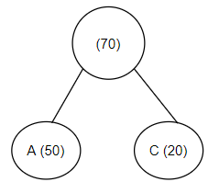
Huffman Encoding Example
Now pick two nodes with smallest keys (frequencies), create a new node and make the two nodes children of this new node. Also put the newly created node back in the heap.
Now the heap has two nodes, one is the node with key=60 and value=B, and the other node is the one newly created with key=70.

Slide 11

Huffman Encoding Example
Now again pick two nodes with smallest keys (frequencies), create a new node and make the two nodes children of this new node.
Put the newly created node in the heap.

Slide 12
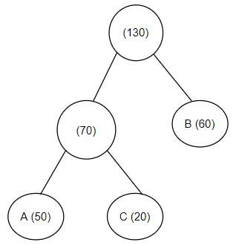
Huffman Encoding Example (Final Tree)
Now the heap has only one node. Our algorithm will stop here. This node in the heap is actually the root node of the final binary tree with leaf nodes containing the characters.

Slide 13
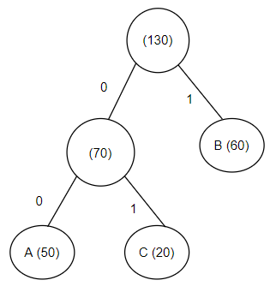
How does this tree Help us in Encoding our Text?

